Slide 1
PHP in Web Environment
Ivan Yonkov
Training Lead
Software University
www.softuni.bg
Forms, Sessions, Cookies

Slide 2
PHP

Slide 3
Hypertext Transfer Protocol
Notes:
HTTP functions as a request–response protocol in the client–server computing model. A web browser, for example, may be the client and an application running on a computer hosting a web site may be the server. The client submits an HTTP request message to the server. The server, which provides resources such as HTML files and other content, or performs other functions on behalf of the client, returns a response message to the client. The response contains completion status information about the request and may also contain requested content in its message body.

Slide 4


HTTP
HTTP request
HTTP response
Web Server

Slide 5
HTTP (2)
Method
Description
GET
Retrieve / load a resource
POST
Create / store a resource
PUT
Update a resource
DELETE
Remove a resource
PATCH
Update resource partially
HEAD
Retrieve the resource's headers
Notes:
Some of the methods (for example, HEAD, GET, OPTIONS and TRACE) are, by convention, defined as safe, which means they are intended only for information retrieval and should not change the state of the server. In other words, they should not have side effects, beyond relatively harmless effects such as logging, caching, the serving of banner advertisements or incrementing a web counter. Making arbitrary GET requests without regard to the context of the application's state should therefore be considered safe. However, this is not mandated by the standard, and it is explicitly acknowledged that it cannot be guaranteed.
By contrast, methods such as POST, PUT, DELETE and PATCH are intended for actions that may cause side effects either on the server, or external side effects such as financial transactions or transmission of email.

Slide 6
HTTP – GET Request
GET /courses/php-web-dev HTTP/1.1
Host: www.softuni.bg
Accept: */*
Accept-Language: bg
Accept-Encoding: gzip, deflate
Mozilla/5.0 (Windows NT 10.0) Chrome/51.0.2704.103
Connection: Keep-Alive
Cache-Control: no-cache
<CRLF>

Slide 7
HTTP – POST Request
HTTP request line
POST /webmail/login.phtml HTTP/1.1
Host: www.abv.bg
Accept: */*
Accept-Language: bg
Accept-Encoding: gzip, deflate
User-Agent: Mozilla/4.0(compatible;MSIE 6.0; Windows NT 5.0)
Connection: Keep-Alive
Cache-Control: no-cache
Content-Length: 59
<CRLF>
LOGIN_USER=john
DOMAIN_NAME=abv.bg
LOGIN_PASS=top*secret!
<CRLF>
HTTP headers
The request body holds the submitted data

Slide 8
HTTP – Response
HTTP response status line
HTTP/1.1 200 OK
Date: Fri, 17 Jul 2010 16:09:18 GMT+2
Server: Apache/2.2.14 (Linux)
Accept-Ranges: bytes
Content-Length: 84
Content-Type: text/html
<CRLF>
<html>
<head><title>Test</title></head>
<body>Test HTML page.</body>
</html>
HTTP response headers
HTTP response body

Slide 9
Developer Tools
Chrome Developer Tools
Mozilla Firefox: Firebug

Slide 10
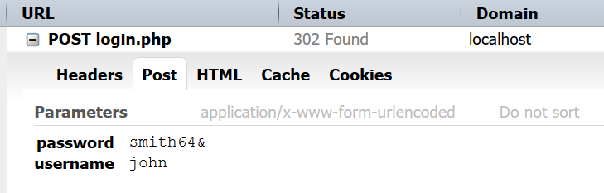
Login Process
Notes:
The client sends form data containing the username and the password.
The application then compares the given credentials and eventually permits the user to use the app.

Slide 11
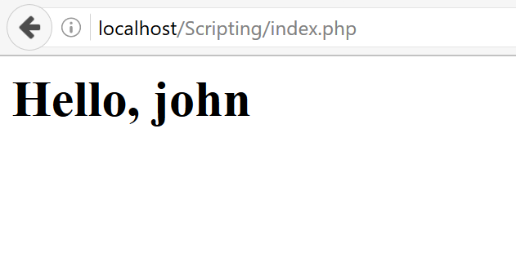
Login Process (2)
Notes:
The user is redirected to another page (index.php), but the application still permits the user to it.
In addition it knows user’s username to show it on the other page.
This is because of the control header that the server has sent to the client in the first handshake. It’s called “Set-Cookie”.

Slide 12
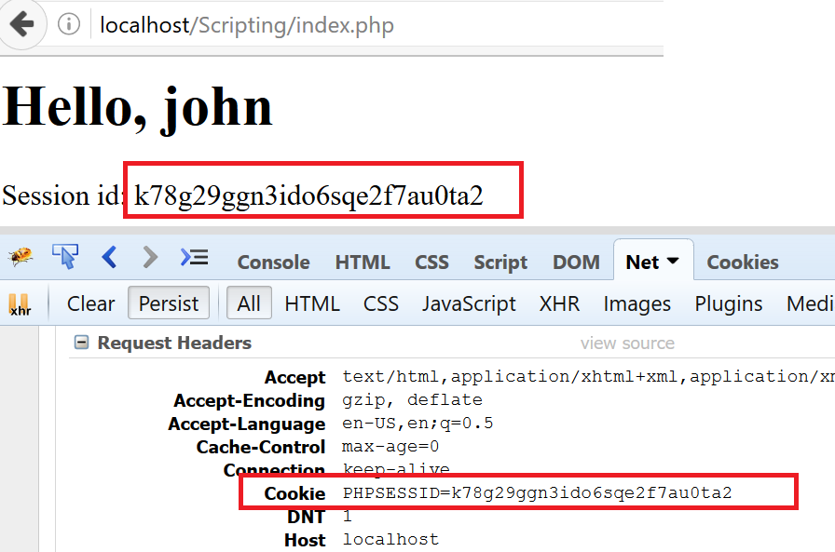
Login Process (3)
Notes:
The Set-Cookie header denotes to the client that they have to write a specific information on the client’s computer and everytime the client tries to communicate with the server to send back this information as “Cookie” header in the request headers.
One kind of cookies are session cookies that are written at the very first time the client requests the server. The session cookies usually contains a hash called session identifier (session id), that’s why the cookies name is often called PHPSESSID (PHP Session Identifier). Other technologies have similar way to name session cookies, for instance Java: “jsessionid”.
The server also stores information about this hash (identifier) and each time one receives the identifier they can operate with the session data, in other words, the data persisted between requests

Slide 13
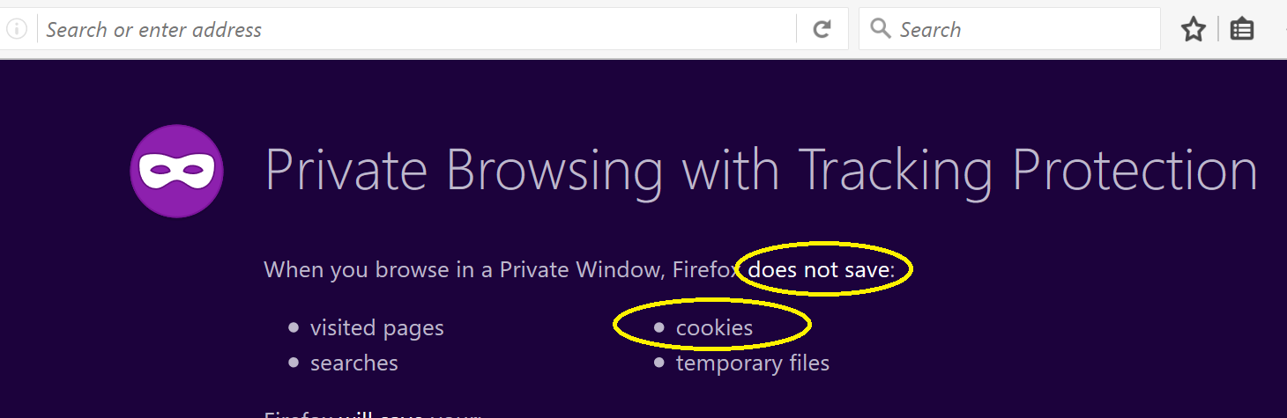
Login Process (4)

Slide 14
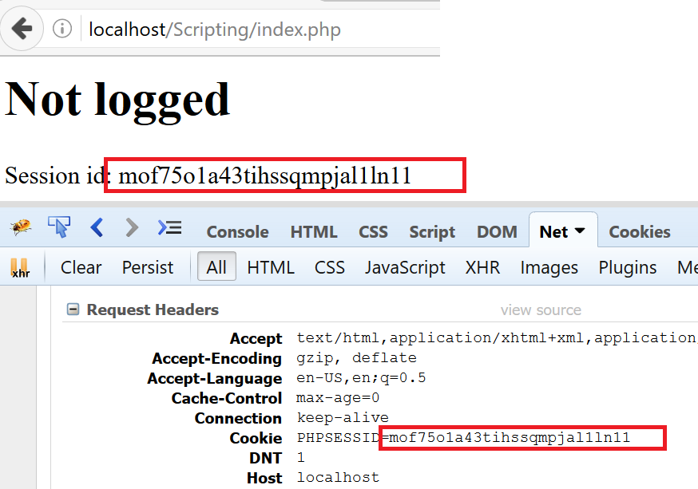
Login Process (5)
Notes:
The hash is now different. The Server does not have any definition for this hash previously logged. So the user is not logged in.
<?php session_start(); if (isset($_SESSION['username'])) { echo "<h1>Hello, {$_SESSION['username']} </h1>"; echo "Session id: " . session_id(); } else { echo "<h1>Not logged</h1>"; echo "Session id: " . session_id(); }

Slide 15
Form Submissions

Slide 16
Form Element
Request Method
<form method="post" action="login.php">
<div class="form-control"> <label for="username">Username:</label> <input type="text" name="username" id="username"/> </div>
Form Data
<div class="form-control"> <label for="password">Password:</label> <input type="password" name="password" id="password"/> </div>
<div class="form-control"> <input type="submit" name="login" id="login-btn" value="Login"/> </div>
Submits Form
</form>
Notes:
A webform, web form or HTML form on a web page allows a user to enter data that is sent to a server for processing. Forms can resemble paper or database forms because web users fill out the forms using checkboxes, radio buttons, or text fields. For example, forms can be used to enter shipping or credit card data to order a product, or can be used to retrieve search results from a search engine.
When data that has been entered into HTML forms is submitted, the names and values in the form elements are encoded and sent to the server in an HTTP request message using GET or POST. Historically, an email transport was also used.^{[5]} The default mime type, Internet media type application/x-www-form-urlencoded, is based on a very early version of the general URI percent-encoding rules, with a number of modifications such as newline normalization and replacing spaces with "+" instead of "%20". Another possible encoding, Internet media type multipart/form-data, is also available and is common for POST-based file submissions.

Slide 17
Handling Superglobals
$_GET && $_POST
Notes:
http://php.net/manual/en/reserved.variables.get.php
http://php.net/manual/en/reserved.variables.post.php

Slide 18
Superglobals
Prefixed with underscore (e.g. $_POST)
Can be accessed from anywhere
Can contain insecure input
function sum() { return $_POST['a'] + $_POST['b']; }

Slide 19
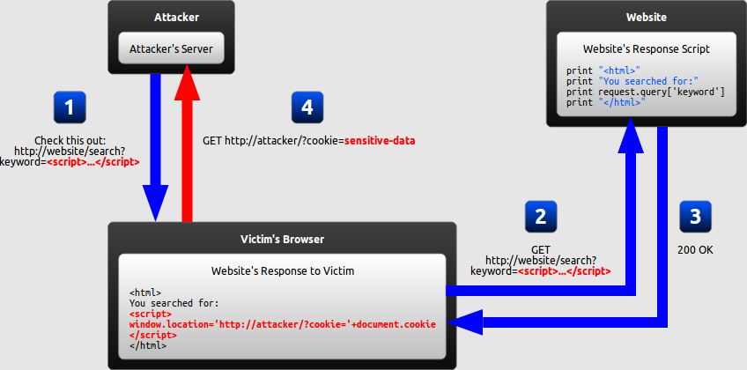
SECURITY LEAKS
Notes:
https://en.wikipedia.org/wiki/Cross-site_scripting

Slide 20
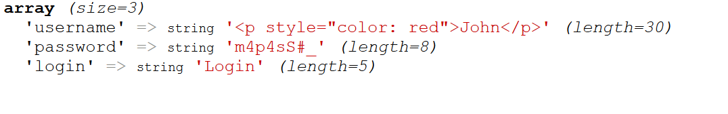
Security Leaks

Slide 21
Security Leaks (2)
<?php $user = isset($_POST['username']) ? $_POST['username'] : "Guest"; ?> <h1>Hello, <?= $user; ?></h1>

Slide 22
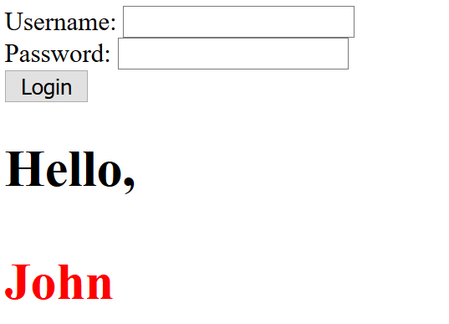
Security Leaks (3)

Slide 23
Security Leaks (4)
<?php $user = isset($_POST['username']) ? $_POST['username'] : "Guest"; ?> <h1>Hello, <?= htmlentities($user); ?></h1>

Slide 24
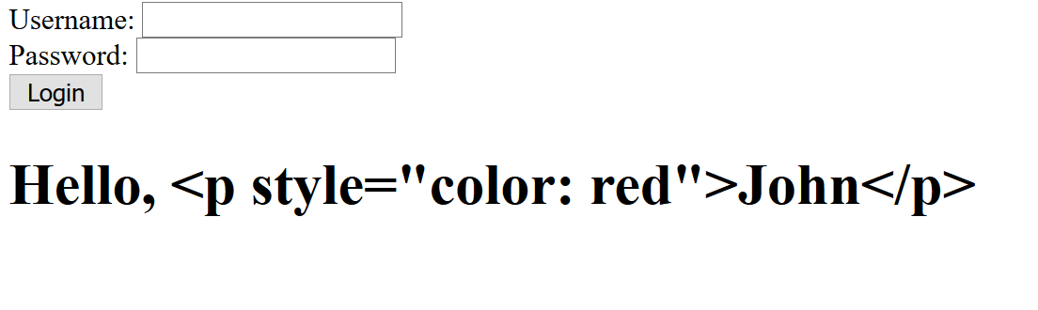
Security Leaks (5)

Slide 25
Persisting Values
Sessions && Cookies
Notes:
http://php.net/manual/en/session.examples.basic.php

Slide 26
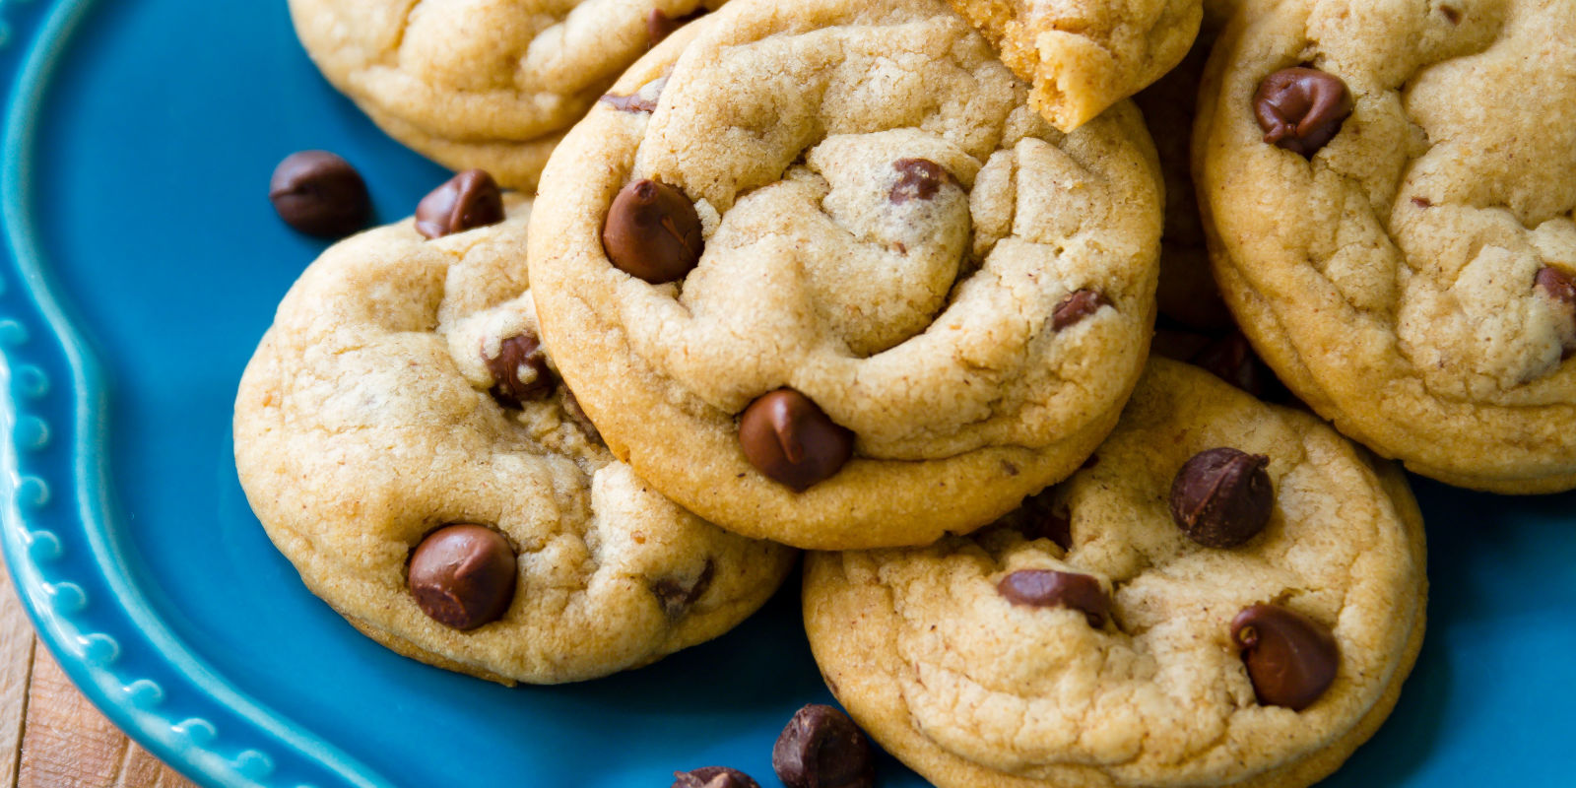
COOKIES
Notes:
http://php.net/manual/en/features.cookies.php

Slide 27
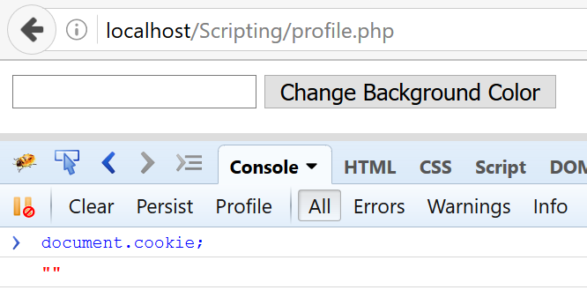
Cookies

Slide 28
Cookies (2)
$colors = ["white", "red", "green", "blue", "orange"];
if (isset($_POST['color'])) {
$color = $_POST['color'];
if (!in_array($color, $colors)) { $color = $colors[0]; }
setcookie('color', $color);
header("Location: profile.php"); exit;
}

Slide 29
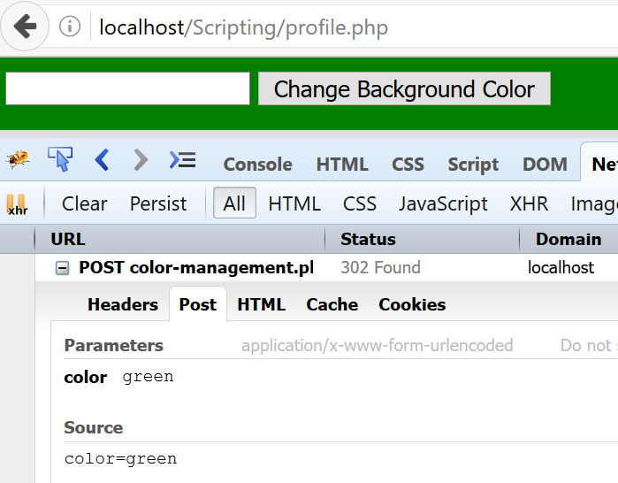
Cookies (3)

Slide 30
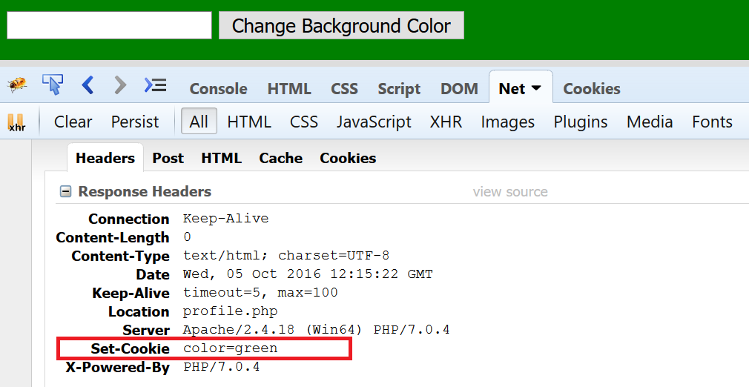
Cookies (4)

Slide 31
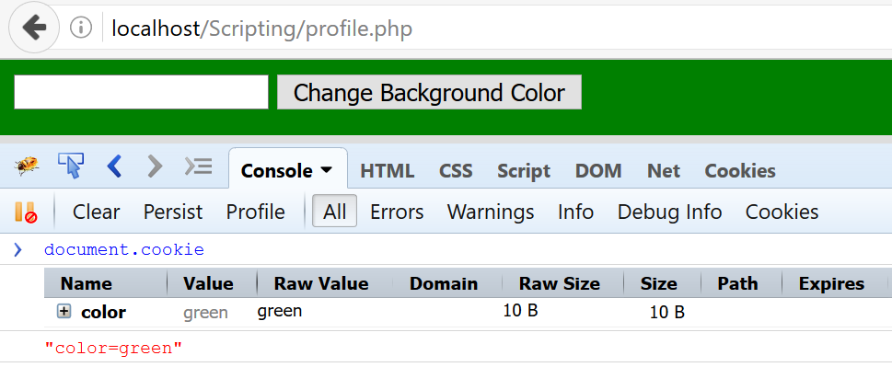
Cookies (5)

Slide 32
Cookies (6)
<html> <?php if (isset($_COOKIE['color'])): ?> <body style="background-color: <?=$_COOKIE['color'];?>"> <?php else: ?> <body> <?php endif; ?> <form action="color-management.php" method="post"> <input type="text" name="color"/> <input type="submit" value="Change Background Color"/> </form> </body> </html>

Slide 33
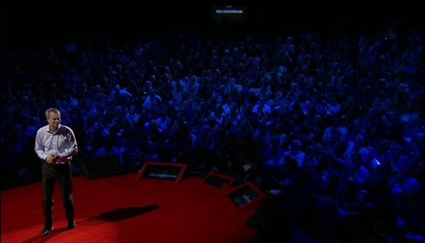
SESSIONS
Notes:
http://stackoverflow.com/questions/6253633/cookie-vs-session

Slide 34
Sessions
session_start();
if (isset($_POST['username'], $_POST['password'])) { $user = $_POST['username']; $pass = $_POST['password']; if ($user == "admin" && $pass == "t0ps3cr3tp4s") { } header("Location: admin.php"); }
$_SESSION['isAdmin'] = true;

Slide 35
Sessions (2)
// admin.php if (isset($_SESSION['isAdmin']) && $_SESSION['isAdmin']) { echo "Welcome to the admin panel"; } else { echo "You are not authorized to this area!"; }
session_start();

Slide 36
Sessions (3)
// admin.php if (isset($_COOKIE['isAdmin']) && $_COOKIE['isAdmin']) { echo "Welcome to the admin panel"; } else { echo "You are not authorized to this area!"; }
Notes:
Do not use COOKIES for sensitive information. The difference between COOKIES and SESSIONS is that the value of the cookie is directly stored into the client’s browser so one can easily modify it.
As oppose the session identifier is created only once and is a key used by the server to store multiple values based on that key. All the session values are kept on the server.

Slide 37
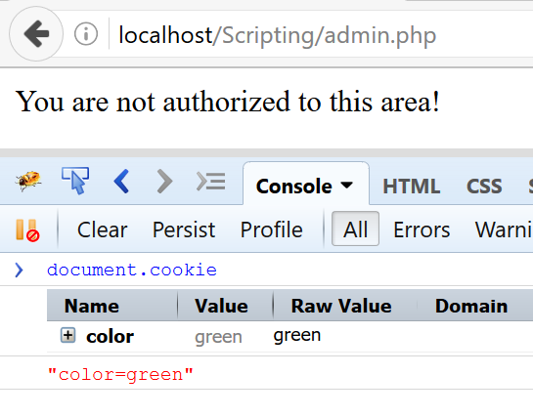
Sessions (4)

Slide 38
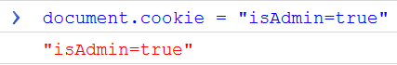
Sessions (5)

Slide 39
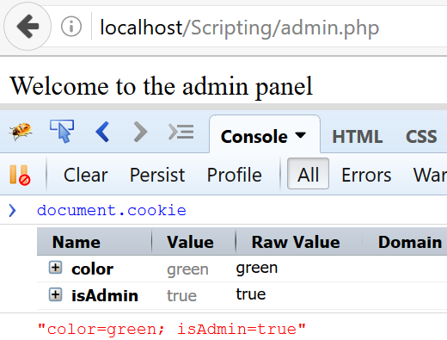
Sessions (6)

Slide 40
Introduction to Web Environment
HTTP Protocol defines the communication between client and server
Clients send information to server through different request methods
HTTP is stateless
So we use Sessions or Cookies

